Slide 1
School Recognition Workgroup Update
Washington State Board of Education
July 11, 2019

Slide 2
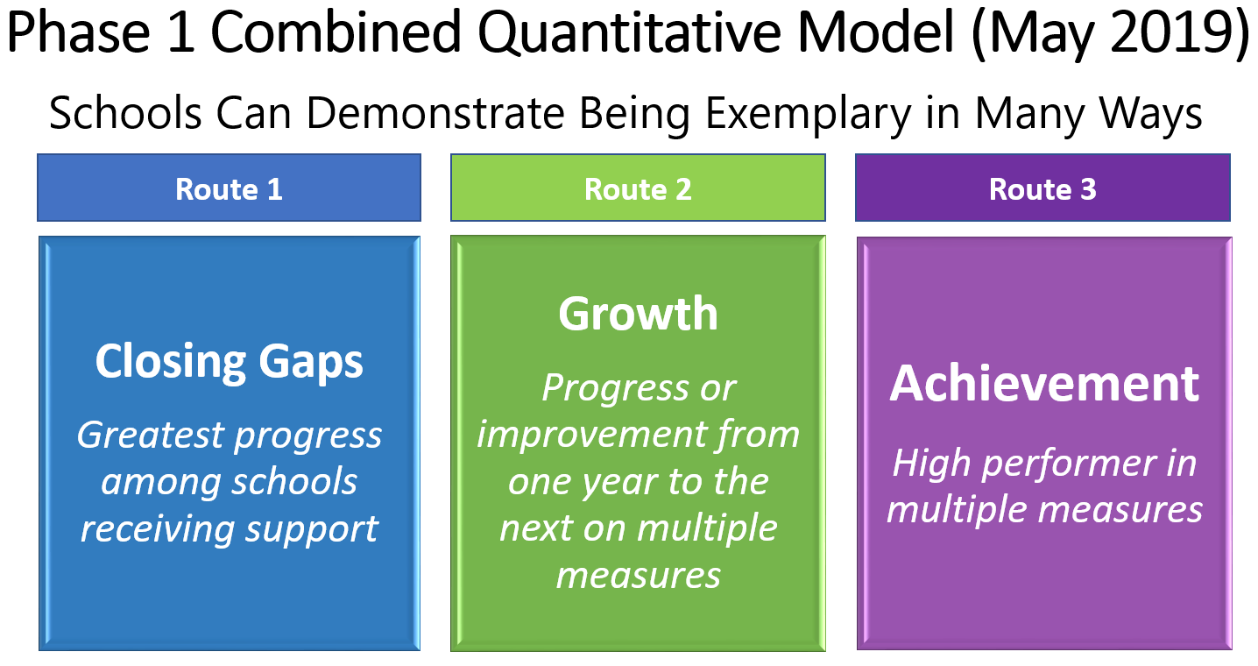
Routes to School Recognition

Slide 3
216 Schools Earned Recognition
 | Closing Gaps | Closing Gaps and Growth | Growth | Growth and Achievement | Achievement | Total
Tier 3: Comprehensive | 24 | 2 | 4 |  |  | 28
Tier 2: Targeted 3+ Groups or Low EL Progress | 13 |  | 2 |  |  | 15
Tier 1: Targeted 1-2 Groups | 71 | 7 | 3 |  |  | 74
Foundational |  |  | 30 | 1 | 68 | 99
Total | 99 | 9 | 39 | 1 | 68 | 216

Slide 4
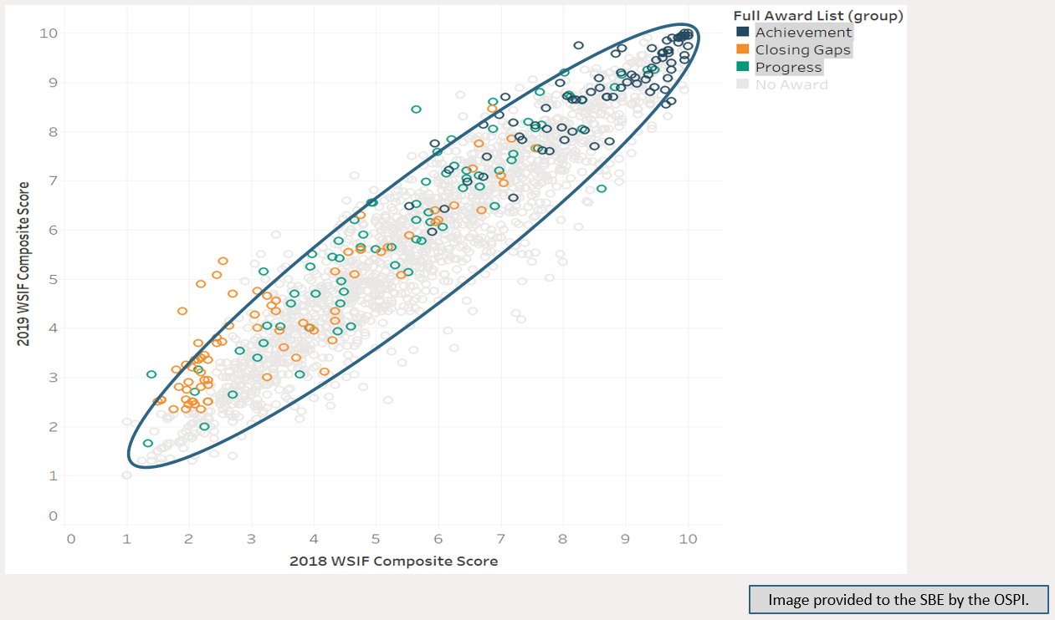
Recognized Schools – Performance Along a Continuum

Slide 5
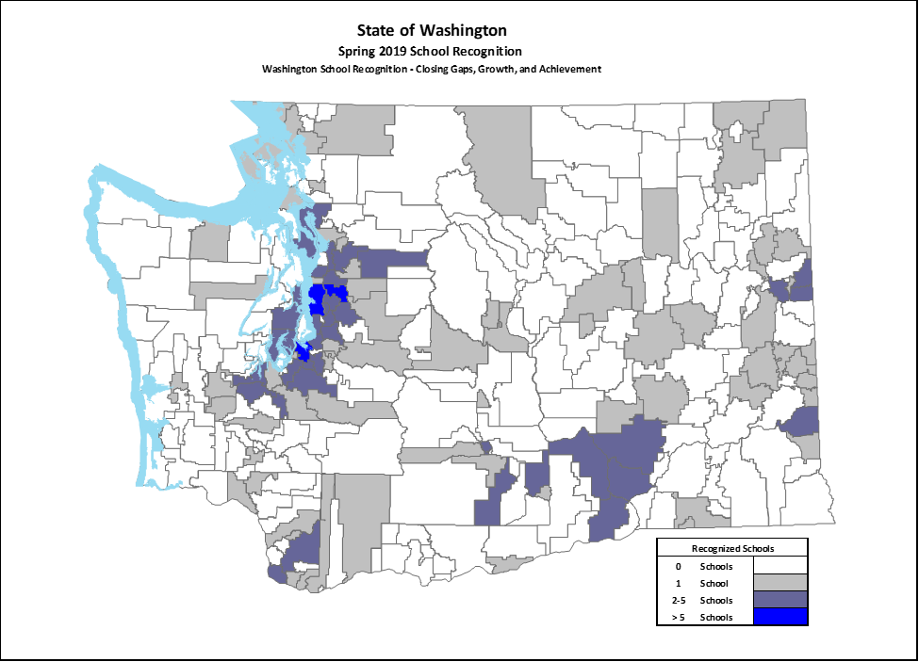
Spring 2019 Recognized Schools
216 schools were recognized
Average FRL rate is 40.1 percent, just a little lower than the average for all schools
Approximately 54 percent of the recognized schools (117/216) were identified for Tier 1-3 supports in the winter 2018 WSIF.
The demography of the recognized schools is similar in many respects to the demography of schools not identified.

Slide 6
Nob Hill Elementary School, Yakima SD
Nob Hill Elementary School was identified for recognition through the Closing Gaps route.
Identified for Targeted Tier 2 Support in winter 2018 WSIF.
The Targeted Support identification was based on the Hispanic, English Learner, and students with a disability student groups.
All three student groups increased by at least 1.00 decile points.
The school has not been recognized in previous years.

Slide 7
South Whidbey Academy, South Whidbey SD
South Whidbey Academy was identified for recognition through the Closing Gaps route.
Identified for Comprehensive Low Grad Rate in winter 2018 WSIF.
Three year rolled up graduation rate (2015, 2016, & 2017) was approximately 52 percent.
The All Students group 2018 four-year graduation rate increased 39 percentage points to 89 percent.

Slide 8
Northport Elementary School, Northport SD
Northport ES was identified for recognition through the Growth route.
In winter 2018 WSIF, the school was identified for the Foundational Support tier.
School had reportable values for five separate WSIF measures.
The school was a top performer in all five of the WSIF measures for which the school had a reportable value.

Slide 9
Recognition through the Achievement Route
Schools recognized for overall excellence in previous years continue to be recognized under the new system.
St. John Elementary School was recognized in each of the previous three years.
Jefferson Middle School was recognized in each of the previous three years.
Rosa Parks Elementary School was recognized in previous years.
Liberty Bell High School was recognized in previous years.

Slide 10
Disproportionately Low Rate of Recognition?
High Schools
 | Recognized Schools when the ESSA Participation Requirement is Applied | Recognized Schools when the ESSA Participation Requirement is Not Applied | Percentage of Schools by School Level in Washington
Elementary Schools | 137 (63.4%) | 139 (58.9%) | 53.1 %
Middle Schools | 34 (15.7%) | 34 (14.4%) | 18.1 %
Combined Schools | 6 (2.8%) | 6 (2.5%) | 4.0 %
High Schools | 22 (10.2%) | 33 (14.0%) | 17.3 %
Combined High Schools | 17 (7.9%) | 24 (10.2%) | 7.5 %
Total | 216 | 236 | 1960
Had the ESSA participation requirement not been in place, 57 high schools (24.2 percent of the total) would have been recognized, which is reflective of the statewide totals.

Slide 11
Recognition - Achievement Route
 | Average Number of Reportable Groups in the Winter 2019 WSIF | Average Number of Reportable Groups for Schools through the Achievement Route
Elementary Schools | 5.9 | 5.1
Middle Schools | 7.1 | 4.6
Combined Schools | 4.5 | 2.0
High Schools | 5.0 | 2.6
Combined High Schools | 2.4 | 2.2
Total | 5.6 | 4.2
It is evident that elementary and middle schools meet the Phase I recognition requirements for the Achievement route even when larger numbers of reportable student groups are present, while high schools with more reportable groups are less likely to meet the recognition requirements.

Slide 12
Recognition – Achievement Route
We see evidence of performance differences based on school level. The meaningfulness of school recognition would be enhanced if Phase II were to be revised in a manner to consider school level as a distinguishing factor. In other words, compare a high school’s performance to other high schools, an elementary school’s performance to other elementary schools, and so on.
 | ELA Prof. | Math Prof. | 4-Year Grad. | Reg. Attend. | 9th Grade On Track | Dual Credit Part. | Total
Elementary Schools | 40 | 42 |  | 38 |  |  | 42
Middle Schools | 5 | 5 |  | 4 |  |  | 5
Combined Schools | 2 | 2 |  | 1 |  |  | 2
High Schools | 11 | 1 | 9 |  | 5 | 4 | 11
Combined High Schools | 4 | 2 | 7 | 5 | 8 | 1 | 9
Total | 62 | 52 | 16 | 48 | 13 | 5 | 69

Slide 13
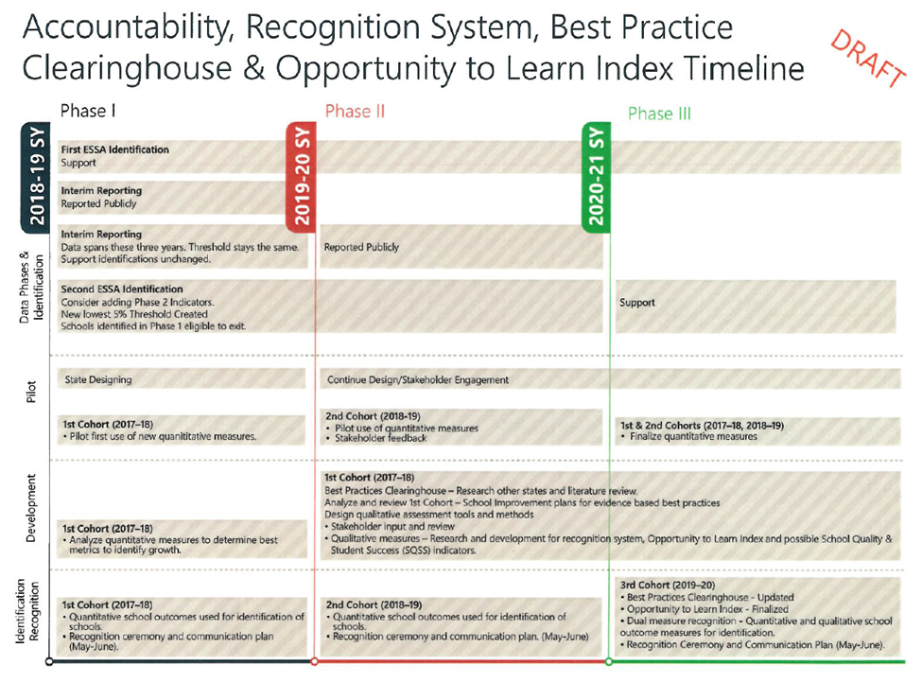
Recognition Workgroup is Entering Phase II

Slide 14
Contact Information
Website: www.SBE.wa.gov
Facebook: www.facebook.com/washingtonSBE
Twitter: @wa_SBE
Email: sbe@k12.wa.us
Phone: 360-725-6025
Web updates: bit.ly/SBEupdates

