Slide 1
Required Action District Rule Revisions
May 8, 2019
State Board of Education
Office of Superintendent of Public Instruction
Chris Reykdal, State Superintendent

Slide 2
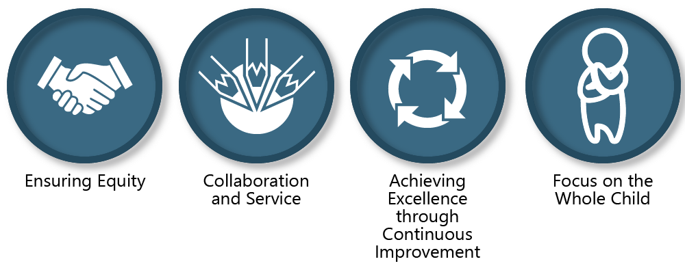
Values-Driven Policy Considerations

Slide 3
Equity Statement
Each student, family, and community possesses strengths and cultural knowledge that benefit their peers, educators, and schools.
Ensuring educational equity:
Goes beyond equality; it requires education leaders to examine the ways current policies and practices result in disparate outcomes for our students of color, students living in poverty, students receiving special education and English Learner services, students who identify as LGBTQ+, and highly mobile student populations.
Requires education leaders to develop an understanding of historical contexts; engage students, families, and community representatives as partners in decision making; and actively dismantle systemic barriers, replacing them with policies and practices that ensure all students have access to the instruction and support they need to succeed in our schools.

Slide 4
Agenda for Today
Overview School Improvement activities in Washington
Update on 2018-19 schools/districts released from RAD
Discuss recommendation for moving RAD forward

Slide 5
System and School Improvement
Education Partners
ESDs
CIPs
Districts
&
Schools
OSPI
OSSI
Education Partners
SBE
WASA
WSSDA
AWSP
WEA
WSCA
Continuous Improvement Partners
Math
English Language Arts
Students with Disabilities
English Learners
Multi-Tiered System of Support
Alternative Learning
Change Management
Data

Slide 6
System and School Support
Before
RAD is now an integrated extension of school improvement activities.

Slide 7
2018-19 Released Districts
Released | Released with RAD-Like Supports
Soap Lake | Marysville
Tacoma | Wellpinit
 | Yakima

Slide 8
2019-2020 RAD Implementation Recommendation

Slide 9
Comprehensive Supports and RAD 2019-2020
Specific, Creative RAD Plans
OSPI / Contractor Partnership

Slide 10
Required Introductory Cohort
Identified according to rule
Provided resource for planning
Accountable for progress

Slide 11
Timeline for Implementation
July 2019 SBE Meeting | Designate Required Introductory Cohort
Nov/Dec 2019 SBE Meeting | Provide status report on RICs
March 2020 | Official designation of RAD

Slide 12
Discussion and Questions?

