Slide 1
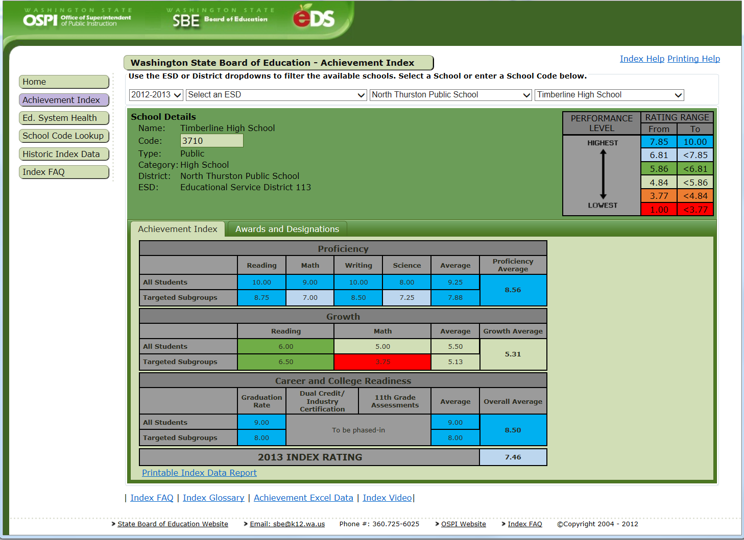
Index Website
https://eds.ospi.k12.wa.us/WAI

Slide 2
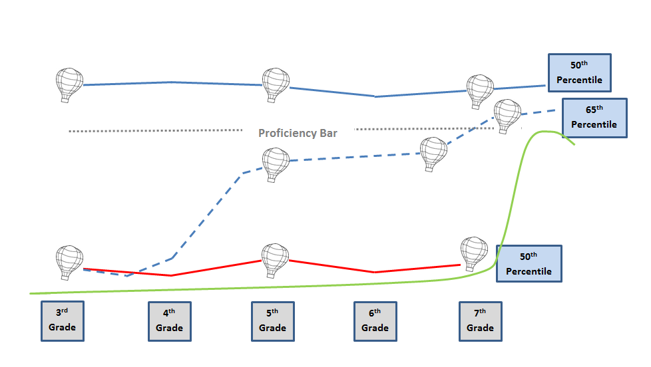
Growth Gap Schematic
Achievement Level 3
Achievement Level 2
Achievement Level 1

Slide 3
Possible Adequate Growth Component
 |  | Reading | Math | Component Average | Overall Average
MSGP | All | 6.00 | 6.00 | 6.00 | 5.30
 | Targeted Subgroups | 4.00 | 5.00 | 4.50
 |  |  | Reading | Math | Component Average | Overall Average | Growth Average
Growth | MSGP | All | 6.00 | 6.00 | 6.00 | 5.30 | 5.39
 |  | Targeted Subgroups | 4.00 | 5.00 | 4.50
 | AGP | All | 7.00 | 5.00 | 6.00 | 5.53
 |  | Targeted Subgroups | 5.25 | 4.88 | 5.06

